Slide 2
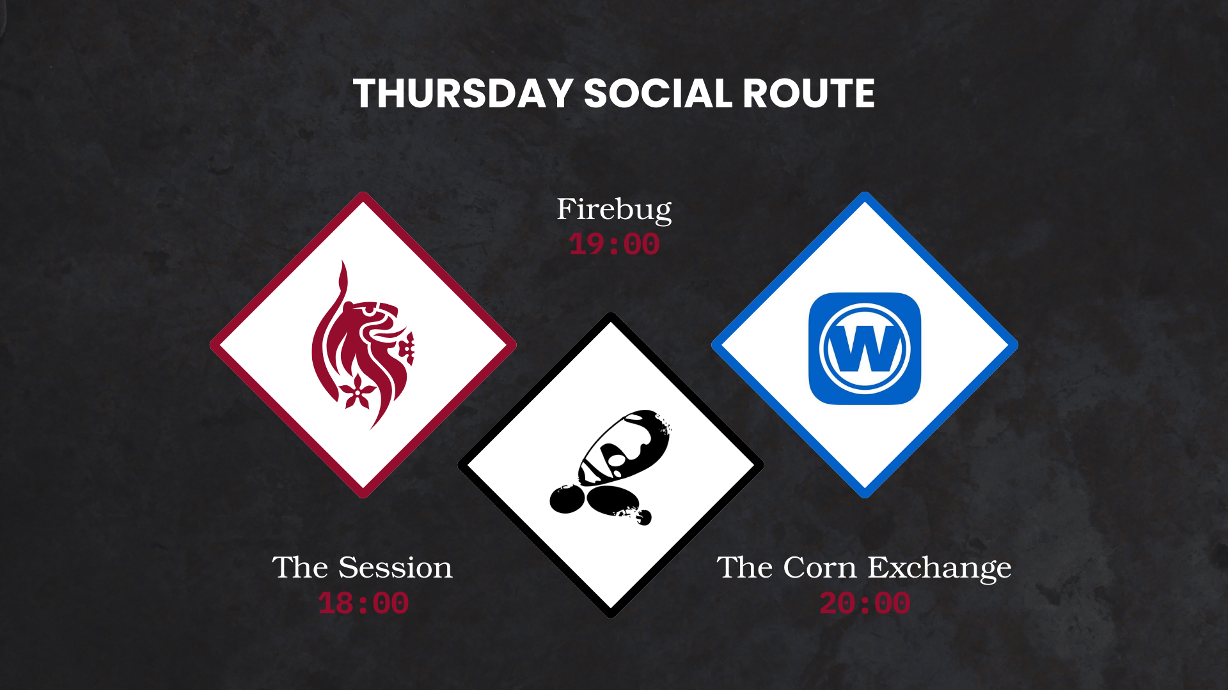

Slide 3


DMU
Hacking Society
Social Engineering

Slide 4



DMU HACKERS
D0nt d0 1ll3gal sh1t
please..

Slide 5
Announcements
DMU HACKERS
Q-Zips are in progress
P2P CTF sign-ups are now live!
Guest talk next week and a proper social :)
PwnEd soon(ish) - get preparing for the Quals

Slide 6
What is Social Engineering?
DMU HACKERS
Social engineering is the term used for a broad range of malicious activities accomplished through human interactions.
It uses psychological manipulation to trick users into making security mistakes or giving away sensitive information.
It works by building false trust, exploiting human error, and using persuasion.

Slide 7
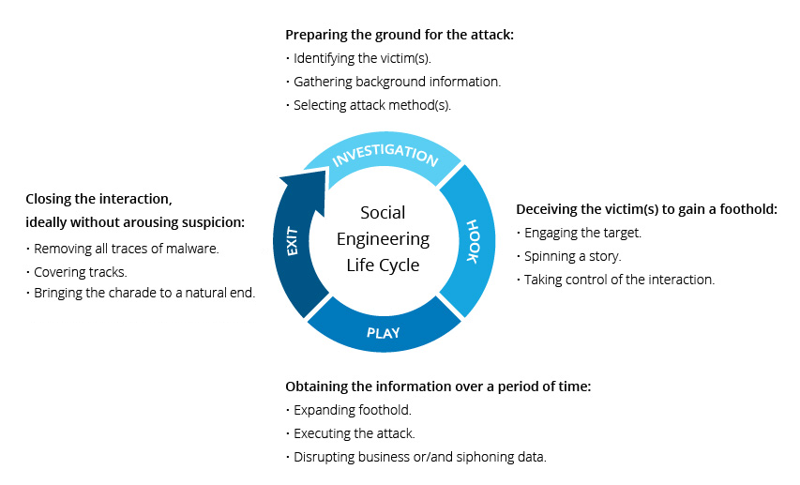
Social Engineering Life Cycle
DMU HACKERS

Slide 8
4 Basic Steps to An Attack
DMU HACKERS
Preparation: The social engineer gathers information about their victims including where to contact them - social media, email, text-messaging platforms
Infiltration: The social engineer contacts their victims, often by impersonating a trustworthy or enticing source
Exploitation: This is where the type of attack can come into play - some attackers may now use their influence to request information from their victims, others will get their victims to click on a link leading them to download malware
Disengagement: After carrying out their attack, the attacker will abruptly break off communication with their victims

Slide 9
Tactics
DMU HACKERS
Pretexting
Baiting
Tailgating
Watering hole attack
Quid Pro Quo
Scareware
Phishing

Slide 10
Pretexting
DMU HACKERS
The threat actor creates a fake situation for the victim, and poses as the right person to resolve it
Ironically, the scammer often claims that the victim has been impacted by a security breach, and then offers to fix it if the victim provides important account information or control over the victims device.
Technically, almost every social engineering attack involves some aspect of pretexting

Slide 11
Baiting
DMU HACKERS
Baiting lures victims into knowingly or unwittingly giving up sensitive information or downloading malicious code by tempting them with a valuable offer or object
This commonly occurs on peer-to-peer sites like social media, where someone might encourage you to download a video or music, but it is actually malware
Probably the best known version of this is the Nigerian Prince scam.
One specific type is USB baiting - STUXNET

Slide 12
Tailgating
DMU HACKERS
Tailgating - sometimes known as ‘piggybacking’ is when an unauthorised person closely follows an authorised area into an are containing sensitive information or valuable assets.
This can be conducted in person, for example, a threat actor can follow an employee through an unlocked door
It can also be a digital tactic, such as when a person leaves a computer unattended while still logged into a private account or network

Slide 13
Watering Hole Attack
DMU HACKERS
This comes from the phrase ‘somebody poisoned the watering hole’
They are a very targeted attack
The attacker will set a trap by compromising a website that is likely to be visited by a particular group of people, rather than targeting that group directly
An example is industry websites that are frequently visited by employees of a certain sector such as energy or a public sector
The attacker is then likely to carry out further attacks once the individuals data or device has been compromised

Slide 14
Quid Pro Quo
DMU HACKERS
Hackers dangle a desirable good or service in exchange for the victim’s sensitive information
E.g. fake contest winnings or seemingly innocent loyalty rewards

Slide 15

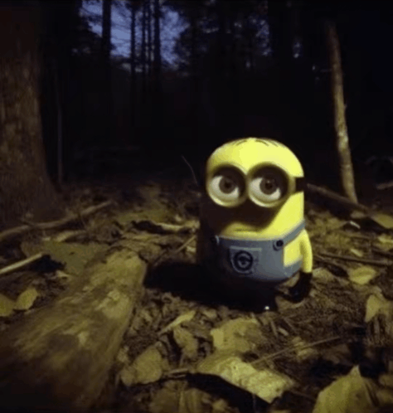

Scareware
DMU HACKERS
A form of malware
It is software that uses fear to manipulate people into sharing confidential information or downloading malware
Ironically, it often comes in the form of pop-ups or emails imploring you to act immediately to get rid of supposed viruses or malware
It can also take the form of a fake law enforcement notice accusing the user of a crime

Slide 16

Phishing
DMU HACKERS
Types of Phishing
Spear Phishing
Smishing
Vishing
Pharming
Whaling
Angler Phishing

Slide 17
Spear Phishing
DMU HACKERS
Spear phishing is a type of phishing attack that targets a specific individual, group or organisation
A classic phishing attack is generally carried out ‘in bulk’ compared to a targeted spear phishing attack
These personalised scams trick victims into divulging sensitive data, downloading malware or sending money to an attacker

Slide 18
Smishing
DMU HACKERS
Smishing is a social engineering attack that uses fake mobile text messages to trick people into downloading malware, sharing sensitive information or sending money to cyber criminals
The term ‘smishing’ is a combination of ‘SMS’ or ‘short message service’, the technology behind text messages, and ‘phishing’

Slide 19
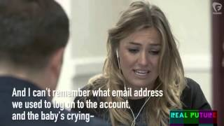
Vishing
DMU HACKERS

Slide 20
Pharming
DMU HACKERS
Pharming is a term used to describe a type of cyber-attack that redirects users to fraudulent websites or manipulates their computer systems to collect sensitive information
Also known as ‘pharmaceutical phishing’ or ‘phishing without a lure’

Slide 21
Whaling
DMU HACKERS
Whale phishing, or whaling, is a type of phishing attack that targets high-level corporate officers with fraudulent emails, text messages or phone calls
The messages are carefully written to manipulate the recipient into divulging sensitive corporate data and personal information or authorising large payments to cybercriminals

Slide 22
Angler Phishing
DMU HACKERS
Angler phishing is a type of phishing attack that targets social media users
A hacker creates a fake social media account and pretends to be a customer service employee working for a company
They then contact customers of that company who have made complaints on social media
Using this disguise, the attacker tries to convince the victims to give up their private data or install malware

Slide 23
How is AI changing social engineering?
DMU HACKERS
AI cybersecurity threats are becoming more advanced and accessible
Massive advancement in AI deep fakes in 2025
Phishing emails can now be formulated on mass via AI tools
Generative AI tools can augment phishing campaigns by dynamically adjusting attacks based on user interaction
LLMs used to generate images and content for facilitating North Korean aligned-threat group ‘Contagious Interview’ in 2025. G1052
Extra Links:
Cybercrime: Lessons learned from a $25m deepfake attack | World Economic Forum
crowdstrike.com | AI Social Engineering

Slide 24

Practical
For this weeks practical, we are going to be using something new.
HACKTORIA is a story driven OSINT CTF tool.
You’re going to be looking into finding information about someone using their social media.

Slide 25

Practical
HACKTORIA - The Spy Who Vanished

